Slide 1
Theme 2. Discrete-to-analogue and analogue-to-discrete converters

Slide 2

Basic principles of digital transforms of sound signals
The conversion of an analog audio signal by temporal sampling and quantization of its selected discrete values ​​inevitably leads to the impossibility of its absolutely accurate restoration
Assume the analog signal is strictly limited in spectrum, then in accordance with the Kotelnikov theorem, it is completely determined by a discrete sequence of its instantaneous values ​​taken with a sampling frequency f_{d} at least twice the cutoff frequency of the spectrum: f_{d} ≥ 2f_{lim}
Quantization of discrete samples of the signal causes noise distortion, the magnitude of which depends on the bit depth of the analog-to-digital converter (ADC), the type of signal being converted, and the shape of the quantizer scale
Sampling a signal with a frequency f_{d} > 2f_{lim} leads to extension of the quantization noise spectrum up to the frequency f_{d}/2, and when the signal is restored, the noise level can be reduced using a low-pass filter with a cutoff frequency approximately equal to f_{lim}
With uniform signal sampling with 2N quantization levels, the signal-to-noise ratio (ADC dynamic range) is estimated in dB according to the formula (C is a constant depending on the shape of the converted signal):
For a sinusoidal signal C = 1.7 dB, for audio signals C changes from -15 dB to 2 dB

Slide 3
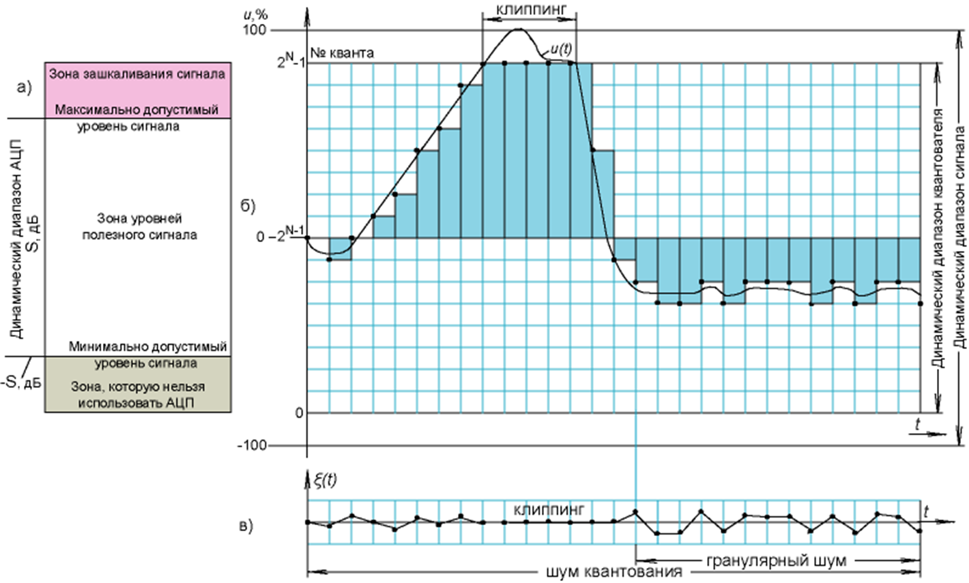
Granular noise, quantization noise, clipping
It’s assumed that in audio equipment the maximum allowed signal level corresponds to 0 dB. In this regard, the value –S characterizes the level of quantization noise and, at the same time, the minimum possible level of the useful signal. From the above relation derives that at f_{d} = 4f_{lim}the noise intensity will decrease by 3 dB
The figure shows a diagram of signal levels during analog-to-digital conversion. It is obvious that the signal samples should not exceed some predetermined maximum allowable level. Otherwise, the quantizer "cuts off" the signal - clip it. The figure also illustrates the formation of quantization noise. When digitally converting an analog signal u(t), the differences between its true values ​​at sampling points and digital samples determine the quantization noise. A specific type of quantization noise is granular noise, which is a result of the instability of the rounding operation, when the audio signal level changes slightly and is located approximately in the middle between the two nearest quantization levels j and j + 1
Clipping
Overload zone
Quants
Maximal possible
level of signal
Useful signal
ADC Dynamic range
Signal dynamic range
Quantizer dynamic range
Minimal possible
level of signal
Forbidden ADC zone
Clipping
Quant. noise
Granular noise

Slide 4
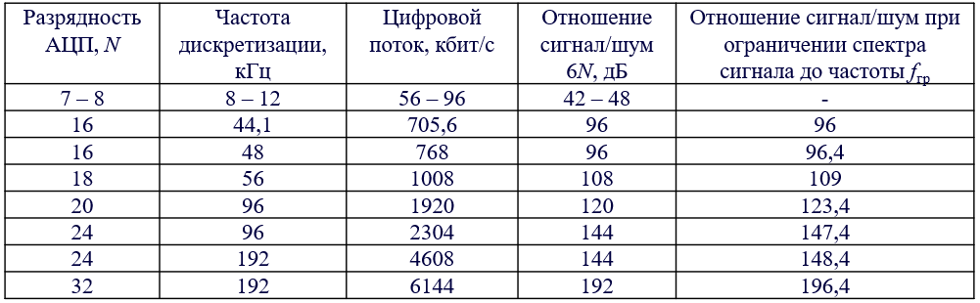
Granular noise, quantization noise, clipping
To digitize speech information limited in spectrum to 2-5 kHz, 7- or 8-bit ADCs at sampling rates from 8 to 10 kHz are usually used
In modern digital systems for processing and encoding audio information, 16-bit quantization and standard sampling rates of 44.1 or 48 kHz are used, limiting the frequency range of the signal to approximately 20 kHz.
In studio equipment, 18-, 20-, 24- and 32-bit quantization is often used at sampling rates of 56, 96 and 192 kHz, which ensures the safety of the higher harmonics of the audio signal, which are not directly perceived by the ear, but affect the formation of the overall sound picture. When limiting the signal spectrum, given that f_{d} > 2f_{lim}, it is possible to further reduce the level of quantization noise
Bit depth
Sampling rate, kHz
Bitrate, kbit/s
SNR, dB
SNR for limited to f_{lim} spectrum, dB

Slide 5
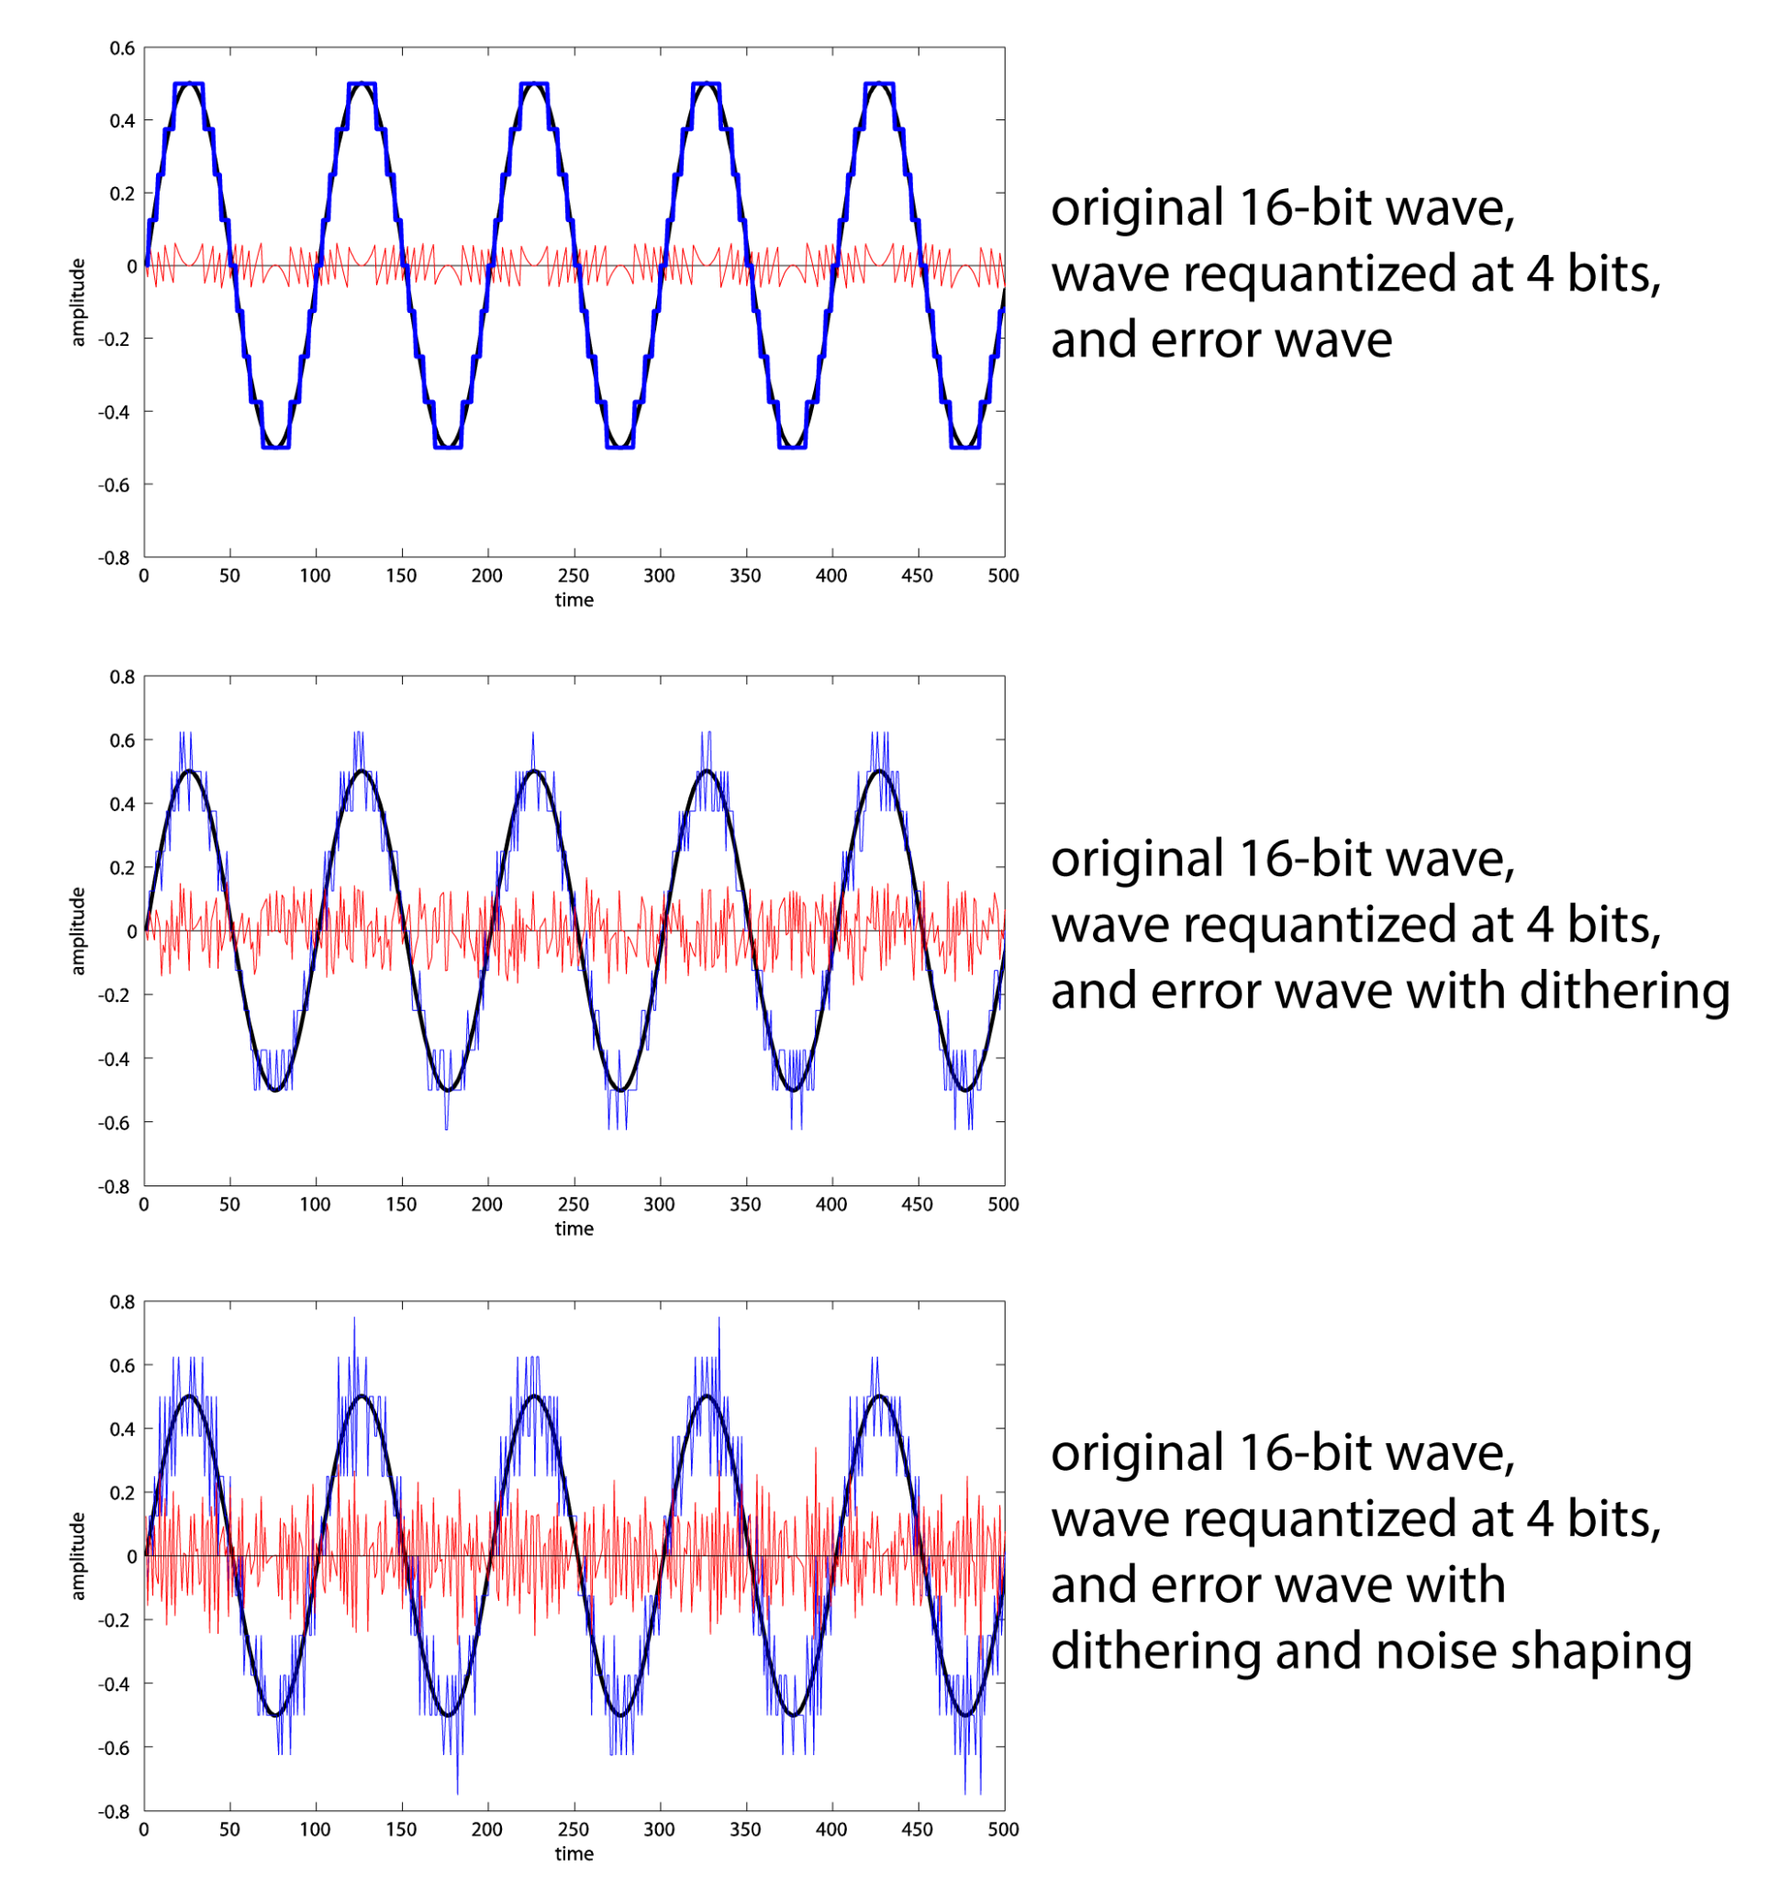
Dithering, noise shaping
Dithering is used in cases where noise significantly depends on the signal being converted and manifests itself by ear in the form of a specific interfering noise (which almost always occurs). The principle of dithering is to add a pseudo-random sequence of small level (no more than two discrete values) noise to the converted signal, thereby realizing the almost complete independence of the noise from the original signal, which is more acceptable for hearing.
Noise shaping transform the noise spectrum so that most of its energy is located in less audible regions of the spectrum in accordance with the shape of equal loudness curves.

Slide 6
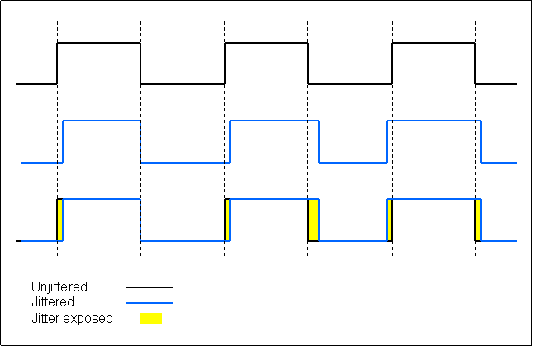
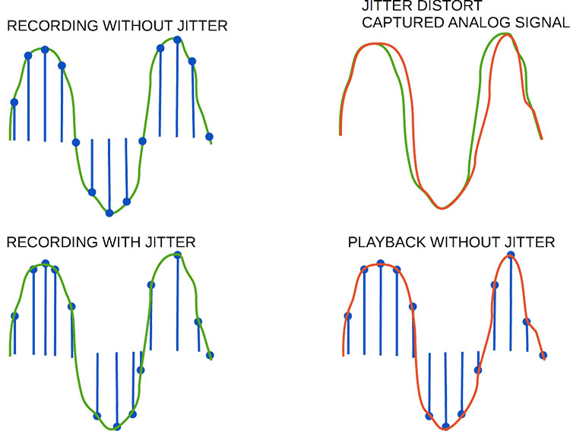
Jitter
Previous methods for converting quantization noise is not always optimal, especially in cases where further processing of audio signals is required.
Therefore, most often, to reduce the effect of quantization noise, audio signals are processed using an ADC with a larger bit depth at a higher sampling rate.
At the same time, the higher the samplerate, the greater the requirements for its stability, since the imperfections of the converting equipment leads to random temporal deviations of the sampling pulses and cause the effect of jitter
To reduce jitter highly stable crystal oscillators are used

Slide 7

Pulse Code Modulation (PCM)
PCM is the simplest way to convert signals, usually containing a multi-bit ADC in the encoder (often with a linear quantization scale) and a DAC in the decoder with the same bit depth
If N is the ADC’s bit depth, and the signal sampling frequency is f_{d}, then the generated digital stream is determined by their product N∙ f_{d} kbps
At the output of the DAC pulsed discrete values ​​of the audio signal are allocated sequentially with the sampling frequency f_{d}. Each of these nearly rectangular pulses of duration τ=1/f_{d} has a sinc-spectrum that smoothly changes from 1 at f = 0 to 2/π at f_{d}/2
If the sampling frequency differs little from the doubled value of the cutoff frequency of the converted signal f_{d} ≈ 2 f_{lim}, then the spectral components of the signal in the cutoff frequency region turn out to be significantly attenuated. Elimination of this effect is possible either by using a low-pass filter with a corresponding increase in the frequency response in the region of the cutoff frequency of the signal, or by using sinc pre-correction of discrete samples of the ADC

Slide 8




Sinc-precorrection
The shape of the frequency response of the precorrective circuit is determined by the formula:
where
- Catalana constant
The series converges fairly quickly, for this reason we can restrict it to a finite number of terms. With an accuracy of more than 0.1%, the pre-correction process is implemented as:
where a₀ = 1.1662, a₁ = -0.1070, a₂ = 0.0345, a₃ = -0.0165, a₄ = 0.0095.

Slide 9
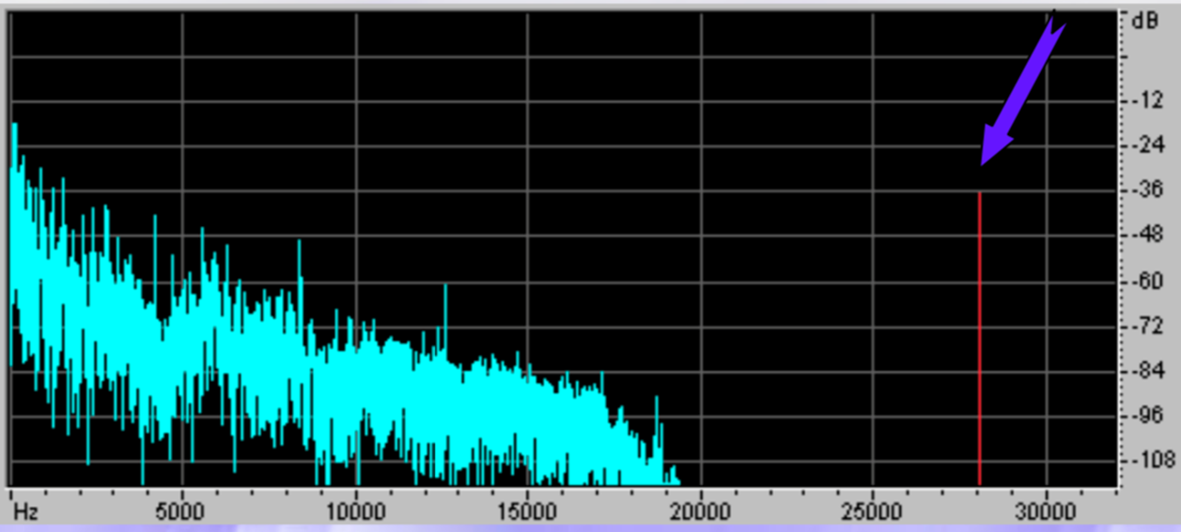
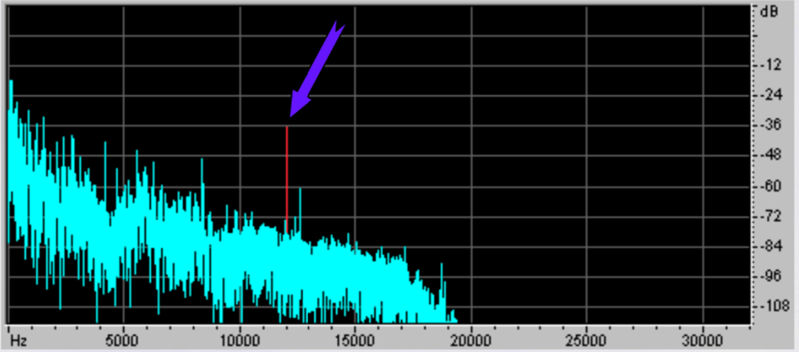
Aliasing
Let the sound not contain frequencies above 20 kHz. Then, according to the Kotelnikov theorem, we can choose a sampling frequency of 40 kHz.
Let noise appear in the sound with a frequency of 28 kHz. The conditions of Kotelnikov's theorem are no longer satisfied.
We will sample at a frequency of 40 kHz, and then we will restore the analog signal by sinc interpolation
The interference bounced off half the sample rate into the lower part of the spectrum and was superimposed on the sound. The interference has moved into the audible range - this is aliasing.
How to avoid aliasing? Apply an anti-aliasing filter before digitizing. It will filter all noise above half the sample rate (above 20 kHz) and pass all signal below 20 kHz.
After this, the conditions of the Kotelnikov theorem will be satisfied and aliasing will not occur. Therefore, it will be possible to restore the original analog signal from the digital signal.

Slide 10




Differential pulse-code modulation (DPCM)
Let’s feed quantizer samples not of the original signal, but the difference between its current value and the predicted value
When using the linear prediction method, the value is determined by the relation
where K and a_{k} are the order and prediction coefficients, are the signal samples obtained at the previous steps of converting the initial values ​​u(n-k)
The formation of is determined by the principle of encoding information about the difference value e(n) and with taking into account the correction Q[e(n)]
The values ​​of the prediction coefficients depend on the correlation properties of the converted audio information and are selected empirically.
For example, when digitizing speech information, a fifth-order predictor with coefficients a₁=0.86, a₂=0.64, a₃=0.40, a₄=0.26, a5=0.20 can be used

Slide 11
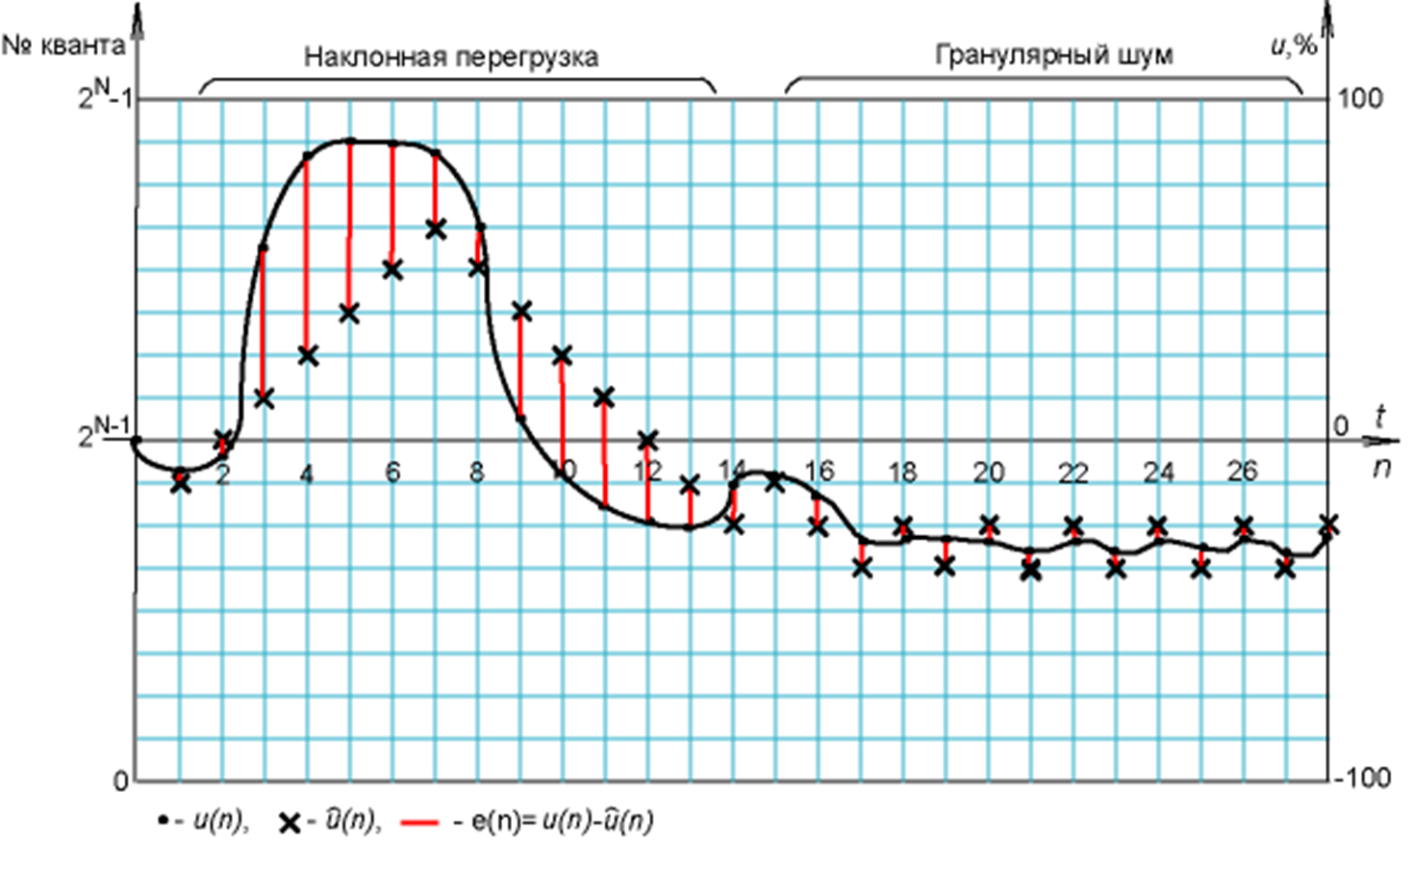



Delta modulation
The simplest predictive coding method is delta modulation (DM), implemented by a one-bit quantizer. The prediction error e(n) and the correction Q[e(n)] are defined by the relations:
The principle of generating a signal at the output of the decoding device:
if Q[e(n)]=1, then the value of the output signal is calculated by the formula where Δ is some discrete signal increment;
if Q[e(n)]=0, the result of the conversion looks like
The use of this type of transformation leads to two types of distortions - steepness overload (slant overload, slope overload), associated with the inability of the encoder to respond to rapid changes in the audio signal sample values, and the granular noise. In this regard, the use of delta modulation is effective for a high correlation of adjacent signal samples and is used at increased sampling rates of audio signals.
Quants
Slope overload
Granular noise

Slide 12
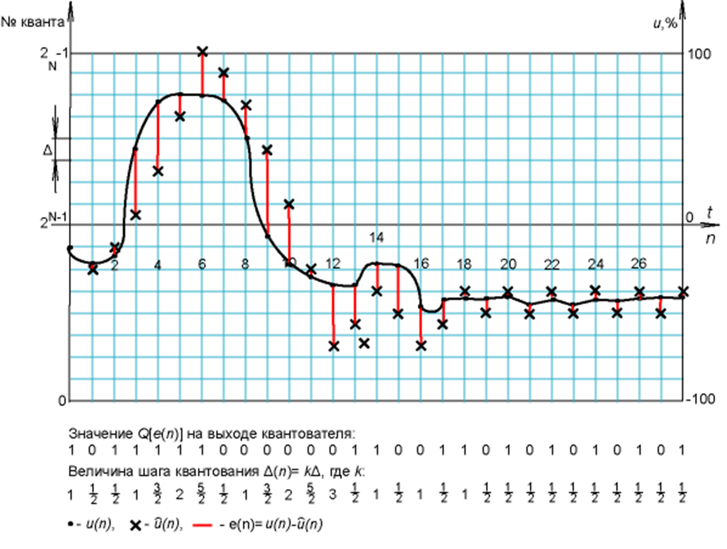


Adaptive delta modulation
More efficient way - adaptive delta modulation (ADM), in which the quantization step changes depending on the nature of the signal samples arriving at the input of the encoder
The simplest way to change the quantization step is illustrated by the following example.
At the initial stage of the transformation, the correction value Q[e(n)]=1 and the value of the quantization step Δ(0)=Δ are taken as the initial quantization step. The subsequent change in the quantization step is carried out in accordance with with the formula:
In addition,
The figure illustrates more efficient coding of a rapidly changing signal and partial compensation for the unwanted effect of slope overload. Granular noise is also compensated by automatic reduce of the quantization step at each new stage of the transformation.
Quants
at quantizer output
Quantizer step

Slide 13
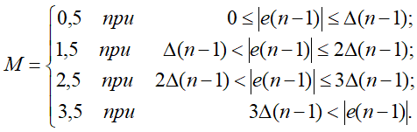
Adaptive relative delta modulation
Even greater coding efficiency of audio information can be obtained with a quantizer using higher order prediction and implementing adaptive relative PCM (ArPCM)
An example of one of the ArPCM options:
The quantization step Δ(n) depends on the encoding result at the previous step Δ(n)=M∙Δ(n-1), and the quantization function Q[e(n)] depends on the value Δ(n) and is transmitted to the decoder in three bits.
The value of the coefficient M, which increases or decreases the quantization step, is determined by the following relationship:
This scheme is efficient, very simple and easy to implement digitally. There are more complex and more efficient schemes for implementing ArPCM with a multi-bit quantization function Q[e(n)]

Slide 14
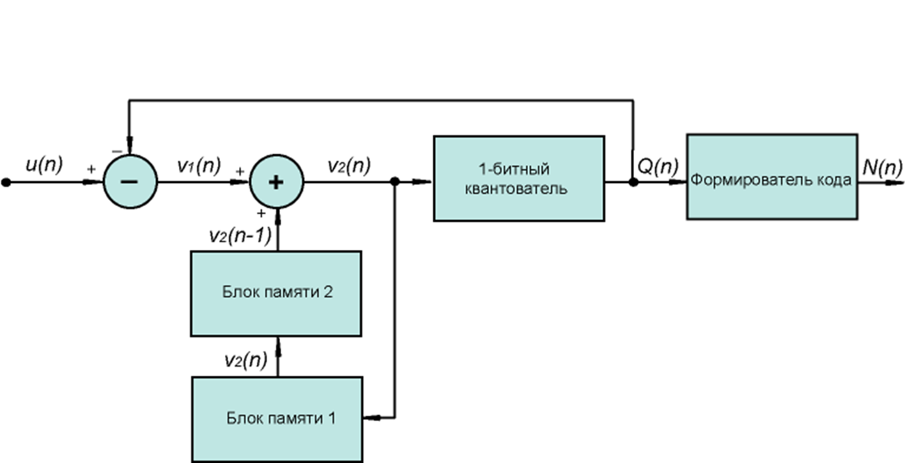
Sigma-delta modulation (SDM)
The basis of sigma-delta modulation is not the analysis of signal increments, but the coding of the levels of the converted signal itself, as in PCM
The block diagram of the sigma-delta modulator is shown in the figure
Discrete samples of the signal u(n) are fed to the input of the modulator, the relative levels of which can vary from –1 to +1
1-bit quantizer
Encoder
2nd memory block
1st memory block

Slide 15

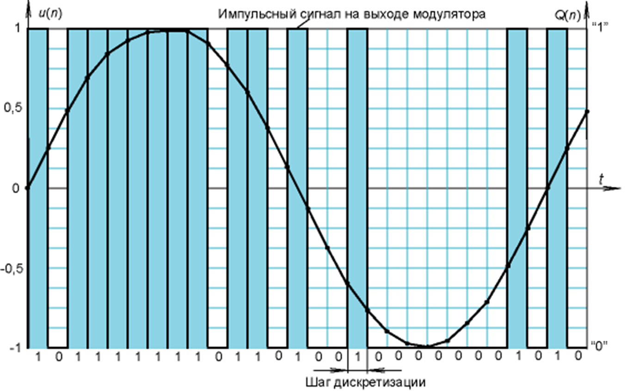

Sigma-delta modulation (SDM)
The encoder contains a one-bit quantizer, at the output of which a signal is generated:
where v₂(n) are discrete samples of the signal at the input of the quantizer, formed as follows:
the subtractor connected at the input of the device provides the formation of the difference between the readings of the input signal u(n) and the output signal of the quantizer Q(n): v₁(n) = u(n) – Q(n);
the samples of the difference signal v₁(n) are fed to the adder from the output of which the samples of the signal v₂(n) are sent in parallel to the inputs of the quantizer and the memory block MB1;
from the output of the block MB1 with a delay of one cycle, the signal samples are fed to the input of the memory block MB2, at the output of which the signal samples of the previous cycle v₂(n - 1) are selected, which are fed to the second input of the adder;
thus, the signal v₂(n) = v₁(n) + v₂(n - 1) is applied to the input of the quantizer.
The code former, switched on at the output of the quantizer, creates a digital sequence in accordance with the relation:
if
1-bit quantizer
Encoder
if
2nd memory block
1st memory block
pulse signal at the output
Sampling step

Slide 16
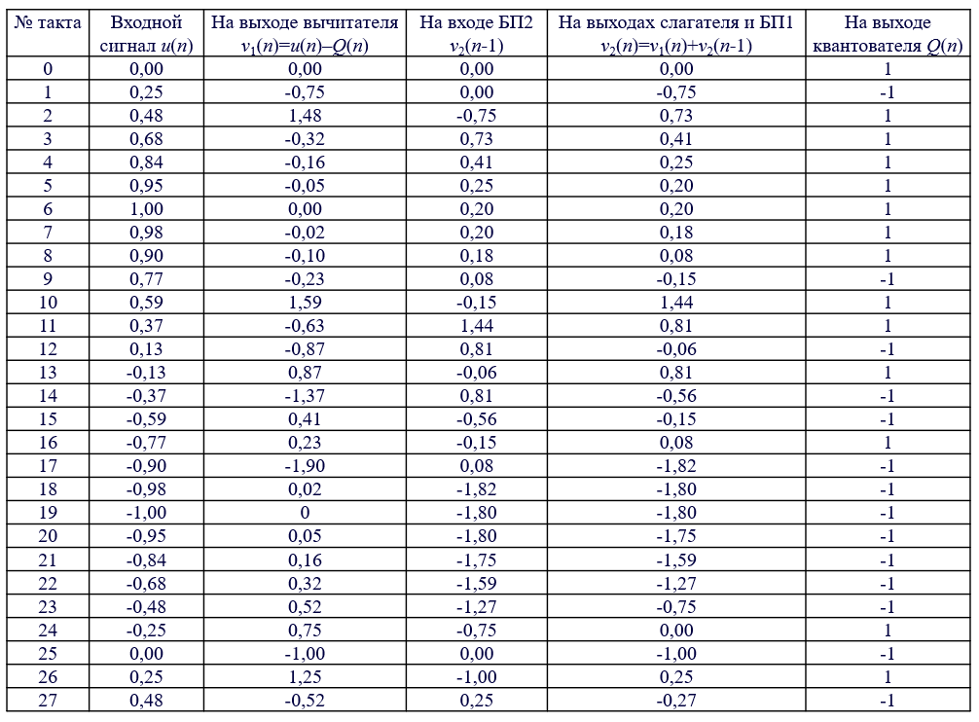
Sigma-delta modulation (SDM)
Step
Input signal (u(n)
Subtractor output v₁(n)=u(n)-Q(n)
MB2
v₂(n-1)
Summator and MB1 outputs v₂(n)=v₁(n)+v₂(n-1)
Quantizer output Q(n)

Slide 17
Sigma-delta modulation (SDM)
Advantages of SDM:
Simple technical implementation (compared to PCM with a linear multi-bit quantizer)
Due to the use of higher sampling rates compared to PCM, quantization noise extends over a wider bandwidth
44.1 kHz / 16 bits - noise in the bandwidth up to 22.05 kHz
SDM 705.6 kHz - noise in the bandwidth up to 352.8 kHz (44.1x16=705.6)
Disadvantages of SDM
High sampling rate for high quality encoding
SDM is also called pulse density modulation (PDM)
SDM format can easily be converted to PCM format

